Slide 1
Wealth - Management Transformation ANALYSIS

Slide 2
INTRODUCTION
Vriyya Inc. provides assistance services to customers who want their wealth to be invested securely and gain good returns
The main request from the client was to move their wealth management infrastructure into the cloud, which we implemented on Azure.
The client provided us csv data with over 10,000 records that needed to be cleaned and evaluated.

Slide 3
OBJECTIVES
To develop a complete ETL process based on analysis of data obtained from various sources.
To implement data migration on the cloud.
Understand Hadoop big data fundamentals, and gain knowledge on implementing big data tools on the cloud.
Implement data visualization for the analyzed data.

Slide 4




HADOOP TOOLS

Slide 5






AZURE BIG DATA TOOLS

Slide 6

STATISTICS
Three
Pipelines
HiveQL
90%
PySparkDF
90%
One
Table
Spark SQL
60%
Rows: 10K
Columns: 39

Slide 7










AZURE BIG DATA SOLUTION
CDATA FACTORY
(Data movement, pipelines & orchestration)
SOURCES
BI
ETL
DATA STORAGE
ANALYSIS
CLIENT DB

Slide 8
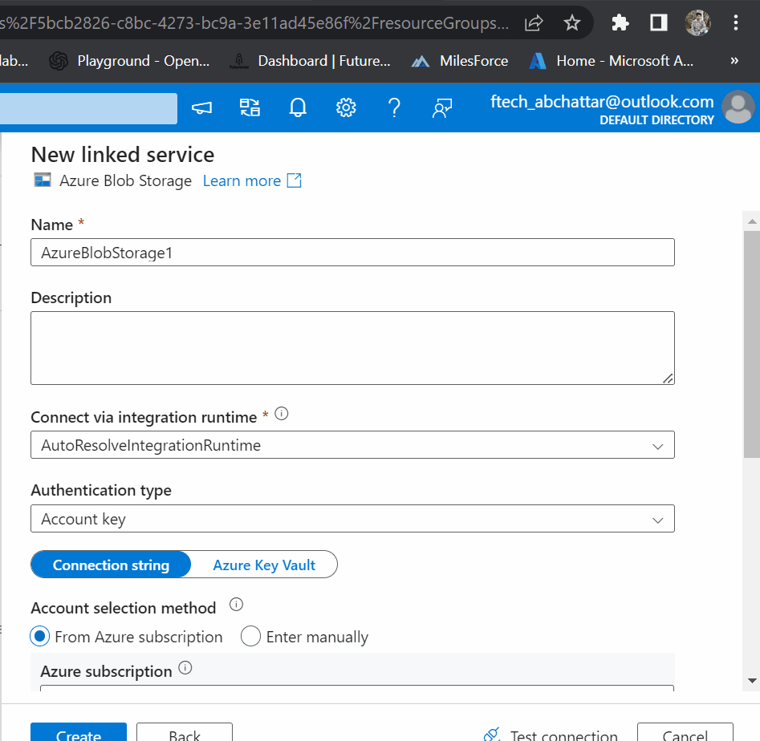
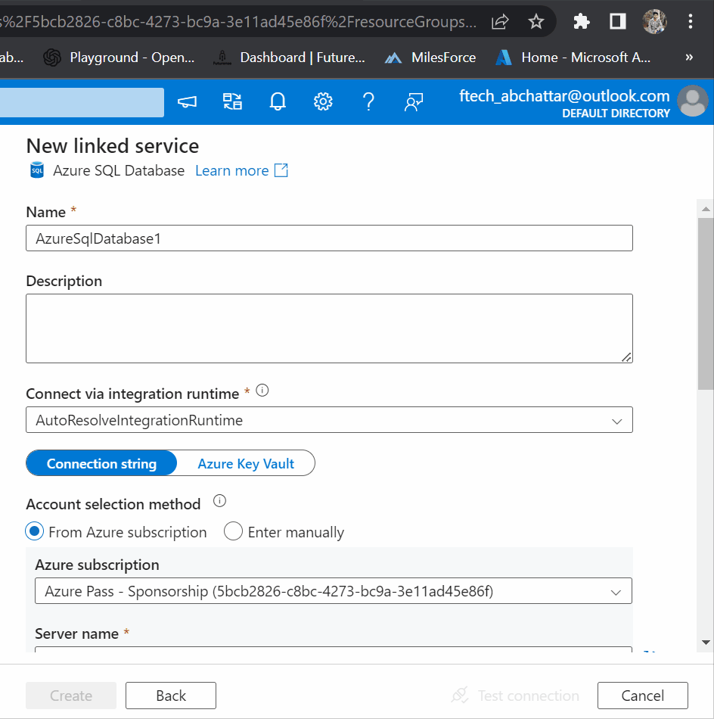
LINKED SERVICE

Slide 9
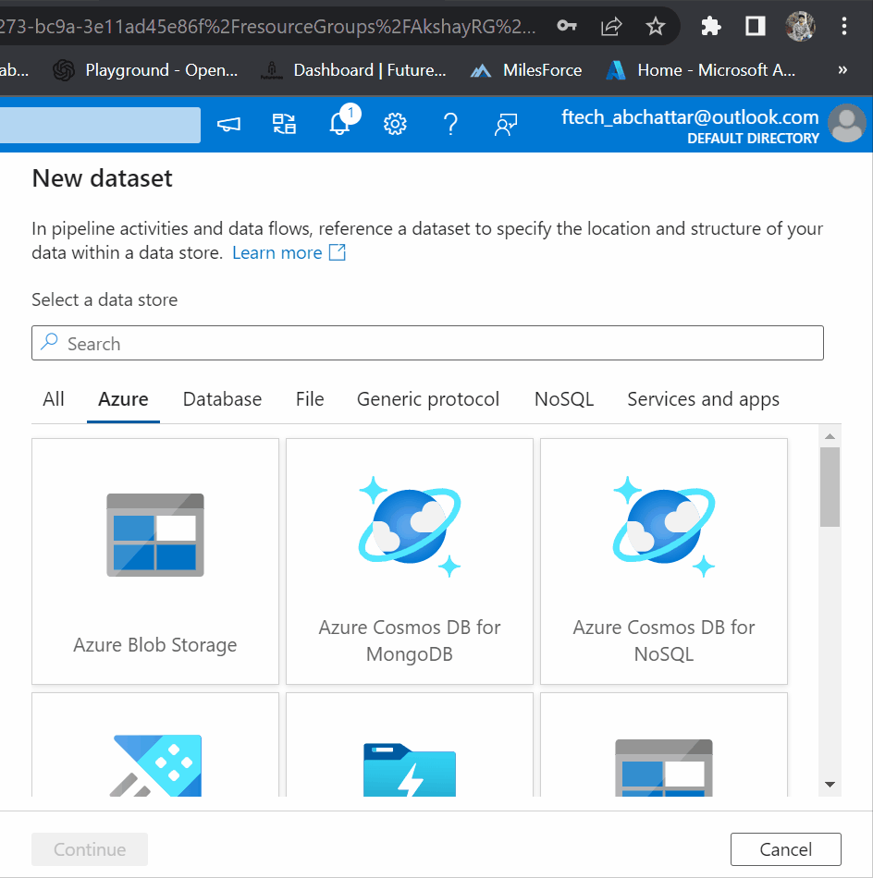
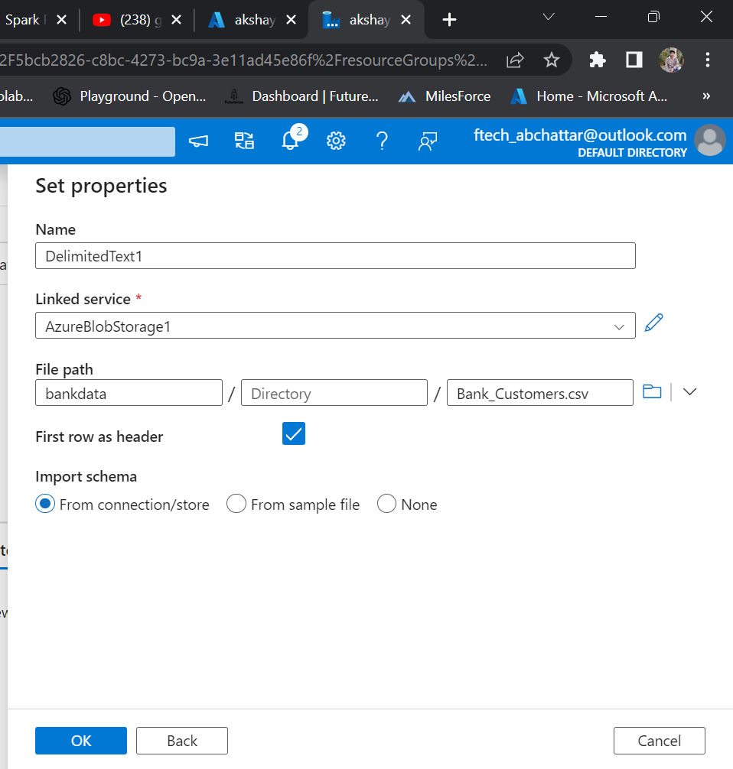
DATASET

Slide 10
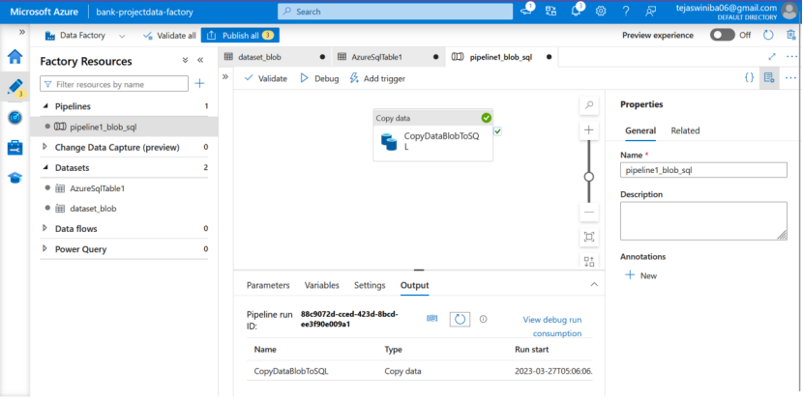
PIPELINE BLOB TO AZURE SQL

Slide 11
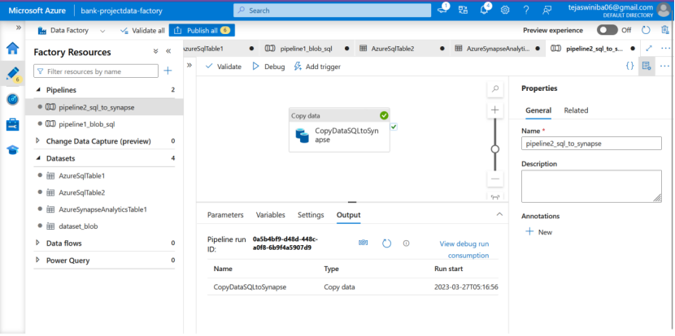
PIPELINE SQL TO SYNAPSE

Slide 12
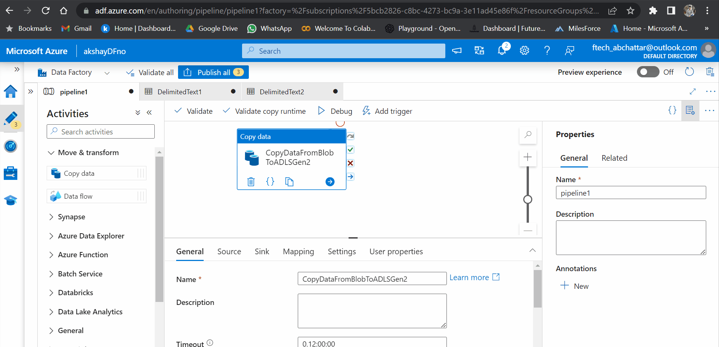
PIPELINE BLOB TO ADLS

Slide 13
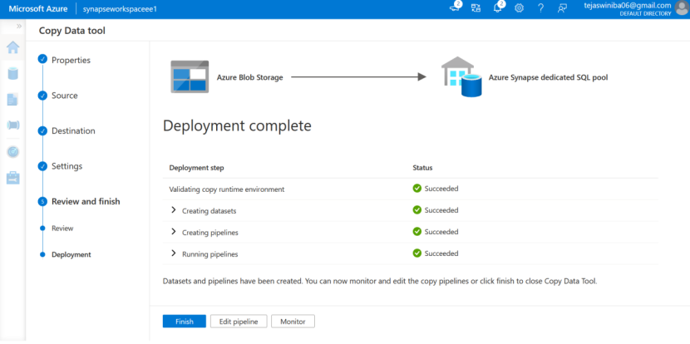
ALTERNATE PIPELINE

Slide 14
HIVE
( v3.1 )

Slide 15
STEPS
IMPORT THE DATASET INTO HDFS
CREATE TABLE AND LOAD DATA INTO HIVE TABLE
RUN THE QUERIES IN HIVE
SAVE THE OUTPUT AS EXTERNAL TABLE
EXPORTING OUTPUT INTO CLIENT DATABASE (MySQL)

Slide 16
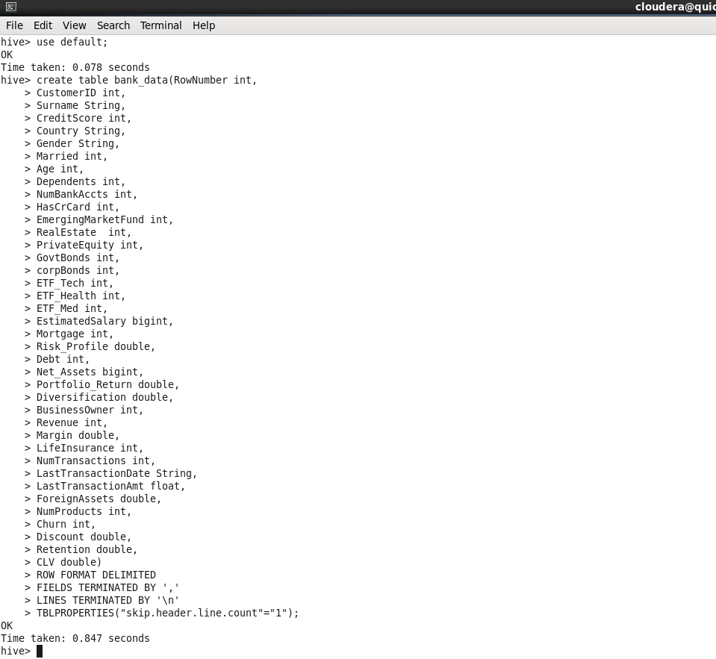
CREATE TABLE IN HIVE

Slide 17
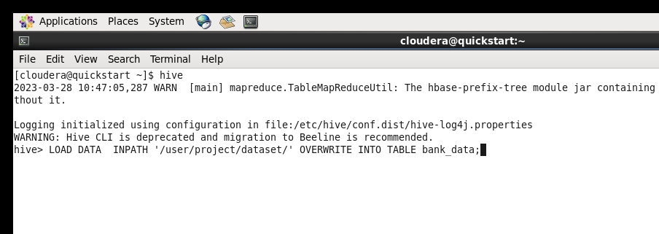
LOADING THE DATA TO TABLE

Slide 18
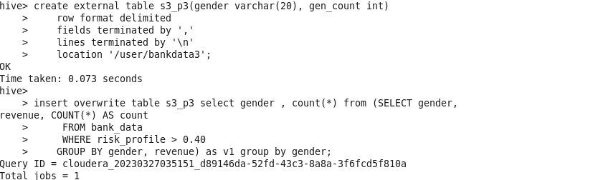
PROBLEM STATEMENT “Retrieve the risk profile based on the revenue, where the risk profile is greater than 0.40 in that how many males and how many females”
select gender , count() from (SELECT gender,revenue, COUNT() AS count
FROM bank_data
WHERE risk_profile > 0.40
GROUP BY gender, revenue) as v1 group by gender;
Storing output into
external table

Slide 19
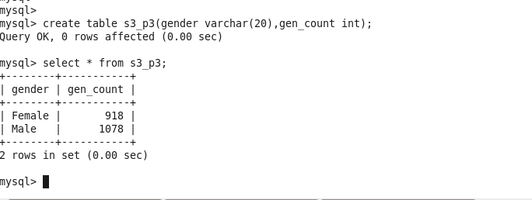
OUTPUT IN CLIENT DATABASE
sqoop export --connect jdbc:mysql://localhost:3306/bankdata --username root --password cloudera --table s3_p3 --export-dir /user/bankdata3/000000_0 --input-fields-terminated-by ',';
Exporting data to client database

Slide 20
PROBLEM STATEMENT “Total number of govt. bonds and corp. bonds by revenue wise and age wise”
SELECT
Revenue_Wise,
Age_Wise,
SUM(GovtBonds),
SUM(corpBonds)
FROM
(SELECT
CASE
WHEN Revenue < 50000 THEN 'Low'
WHEN Revenue BETWEEN 50000 AND 100000 THEN 'Medium'
ELSE 'High'
END AS Revenue_Wise,
CASE
WHEN Age < 30 THEN 'Under 30'
WHEN Age < 50 THEN 'Between 30 and 50'
ELSE 'Above 50'
END AS Age_Wise,
GovtBonds,
corpBonds
FROM
bank_data
) sub
GROUP BY Revenue_Wise,Age_Wise;

Slide 21
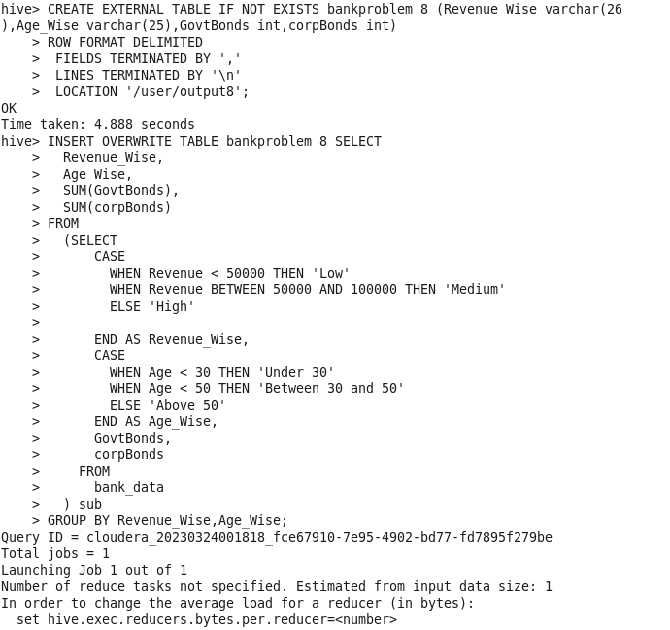
Storing output into
external table
sqoop export --connect jdbc:mysql://localhost:3306/bankdata --username root --password cloudera --table bank_4 --export-dir /user/output8/000000_0 --input-fields-terminated-by ',';
Exporting data to client database

Slide 22
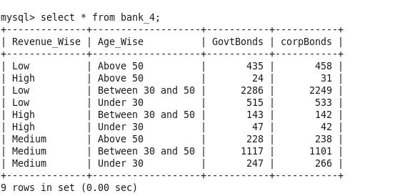
OUTPUT IN CLIENT DATABASE:-

Slide 23

pyspark
( v3.3.0 )

Slide 24
INTRODUCTION
PySpark provides Py4j library, with the help of this library, Python can be easily integrated with Apache Spark
PySpark framework shows low latency due to in-memory processing
one of the most preferable frameworks for processing huge datasets because it is compatible with various languages

Slide 25
STEPS
LAUNCH DATABRICKS WORKSPACE
CREATE A CLUSTER
READ THE BANK DATASET FROM DBFS
CREATE A NOTEBOOK AND PERFORM DATAFRAME OPERATIONS

Slide 26
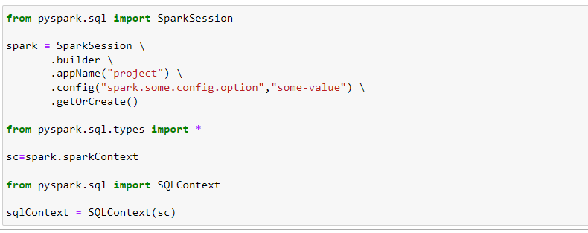
IMPORTING LIBRARIES

Slide 27
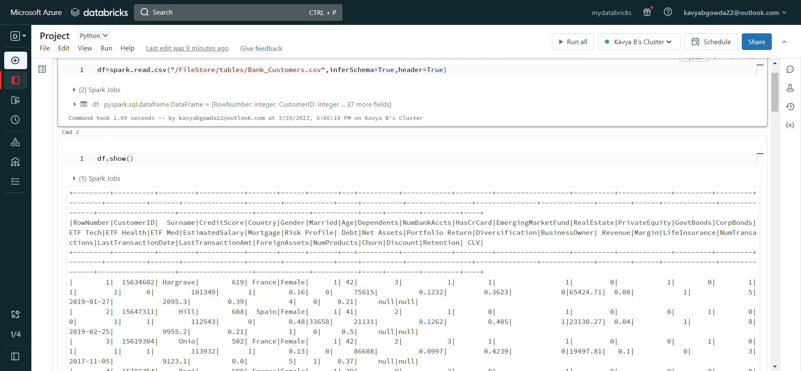
IMPORTING DATASET

Slide 28
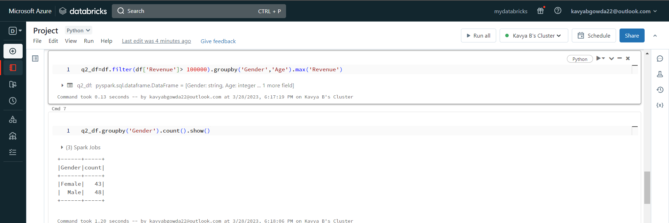
PROBLEM STATEMENT
“What is the highest revenue by age-wise, greater than 1 lakh, in this how many males and females getting more than one lakh revenue”

Slide 29
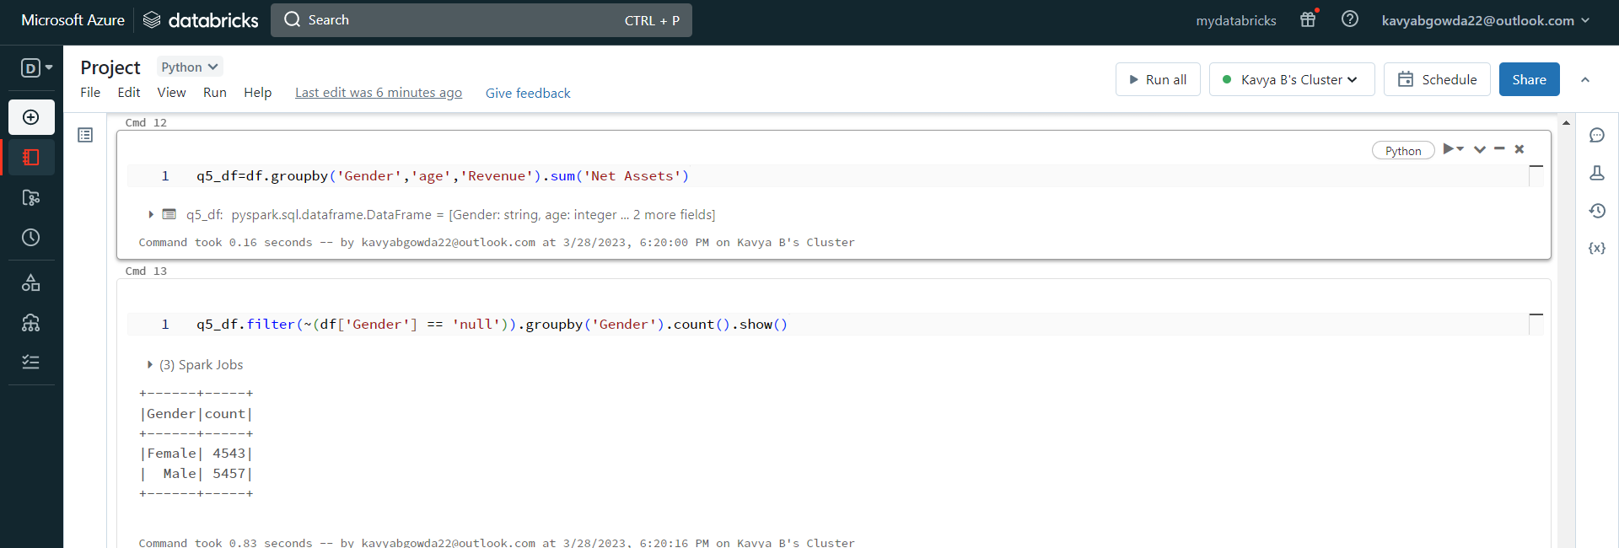
PROBLEM STATEMENT “Retrieve the total number of net assets by age-wise, by revenue-wise, and who has the highest net assets by gender i.e. by male and female”

Slide 30
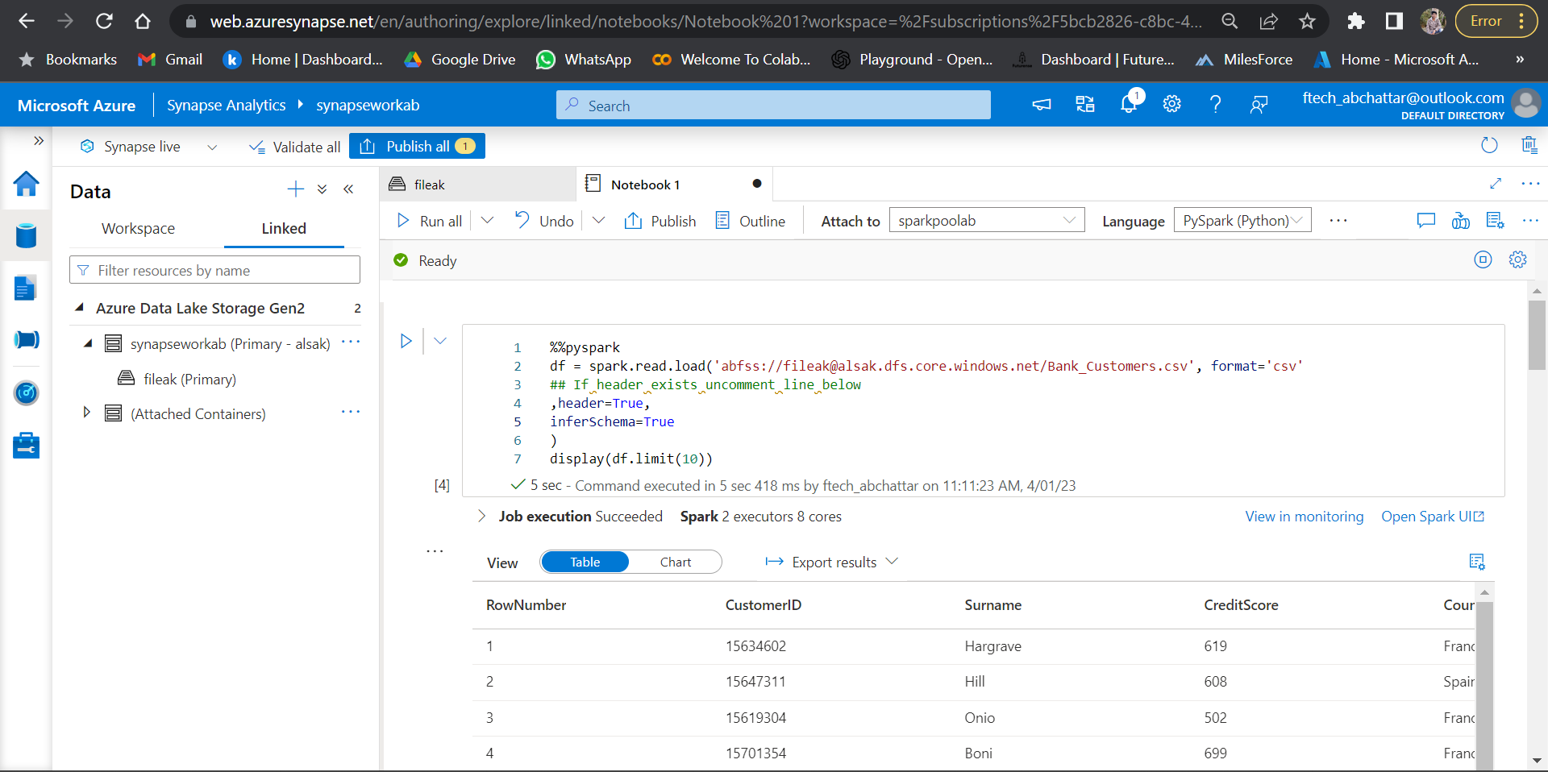
SYNAPSE ANALYTICS

Slide 31
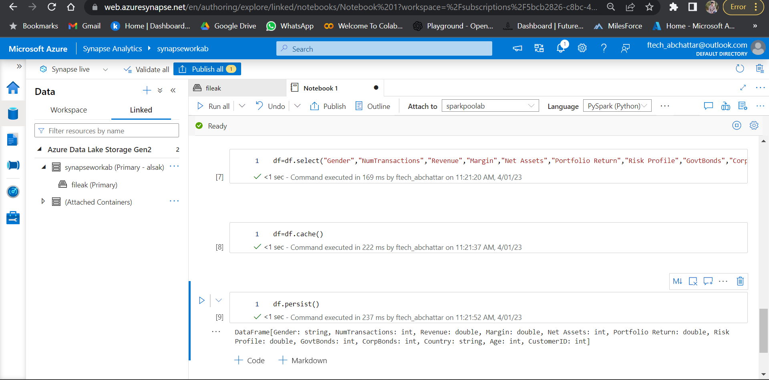
SYNAPSE ANALYTICS

Slide 32
sparkSQL
( v3.3.0 )

Slide 33
INTRODUCTION
Spark SQL is a Spark module for Structured data processing
It provides a programming abstraction called Dataframes and also acts as distributed SQL query engine
Spark SQL was built to overcome the limitations of Apache Hive running on top of Spark
It also includes a cost-based optimizer, columnar storage, and code generation to make queries fast

Slide 34
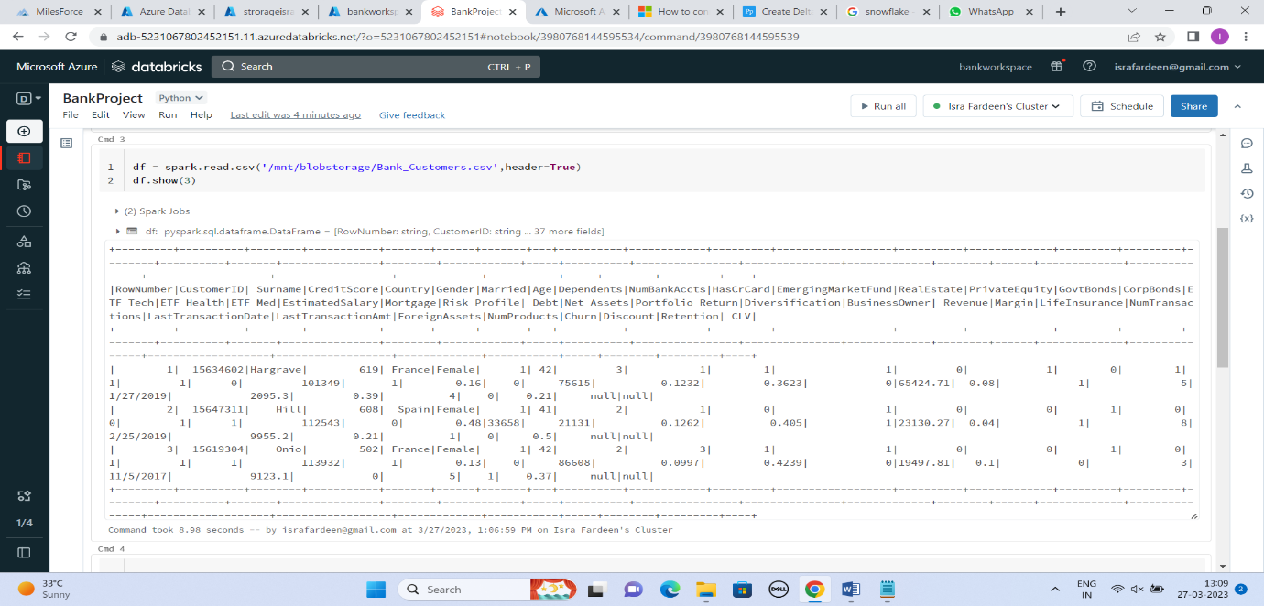
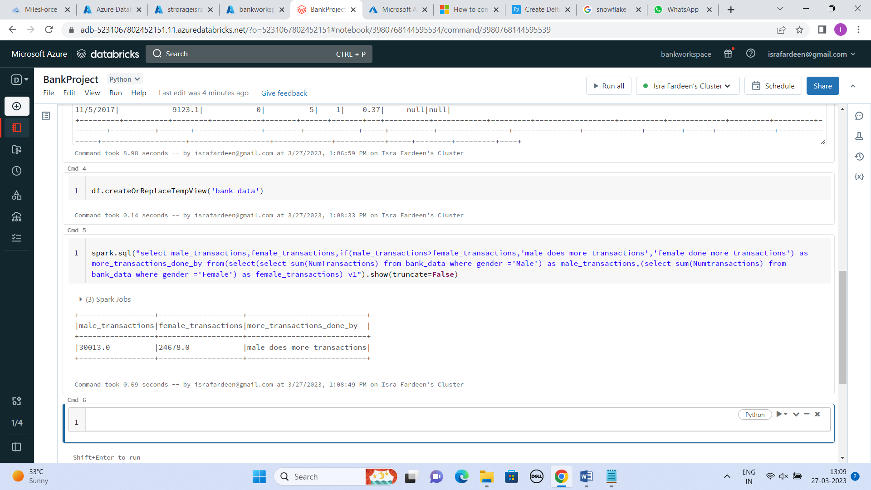
IMPORTING DATASETS

Slide 35
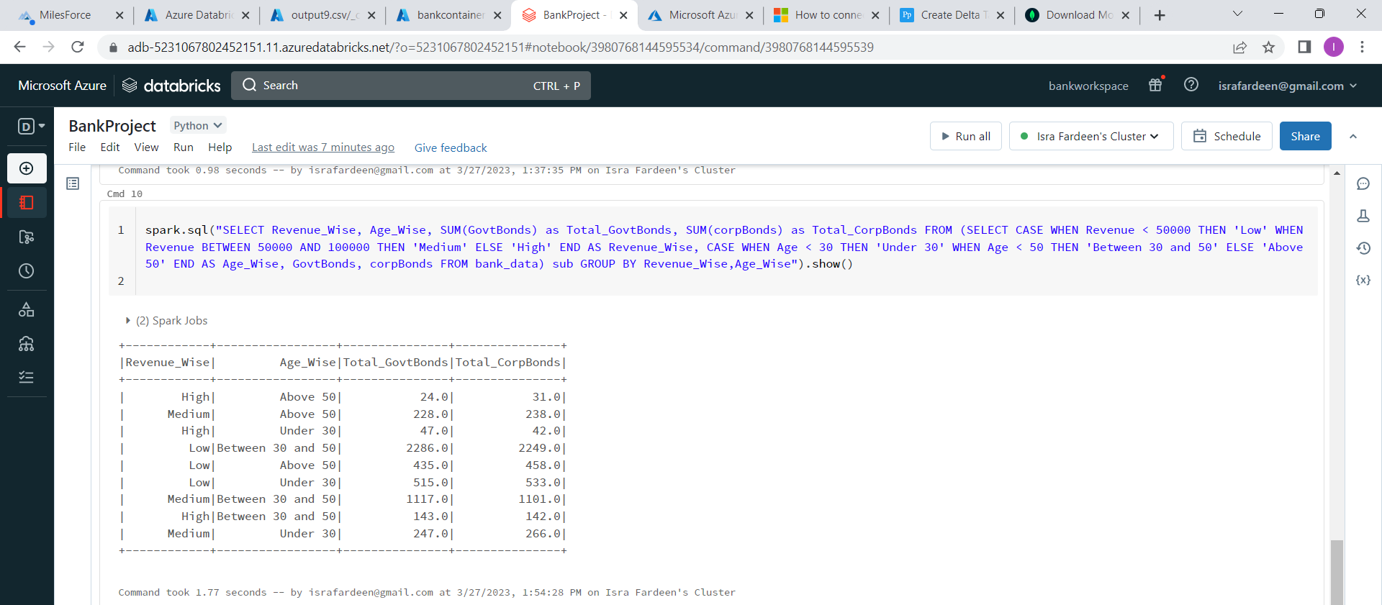
PROBLEM STATEMENT “Total number of govt. bonds and corp. bonds by revenue wise and age wise”

Slide 36
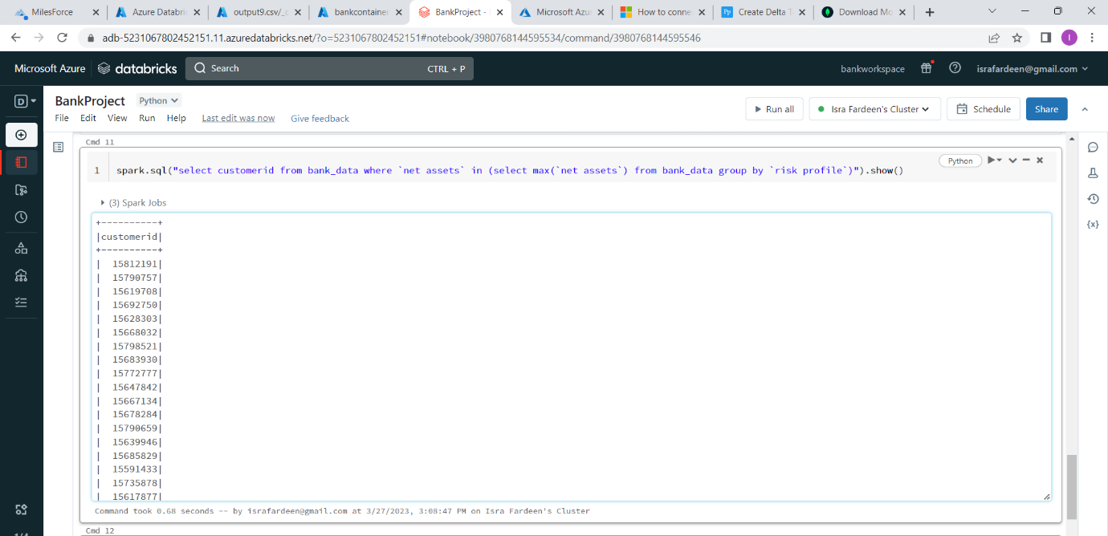
PROBLEM STATEMENT “Retrieve the customerIDs who has the highest net assets by risk profiles”

Slide 37
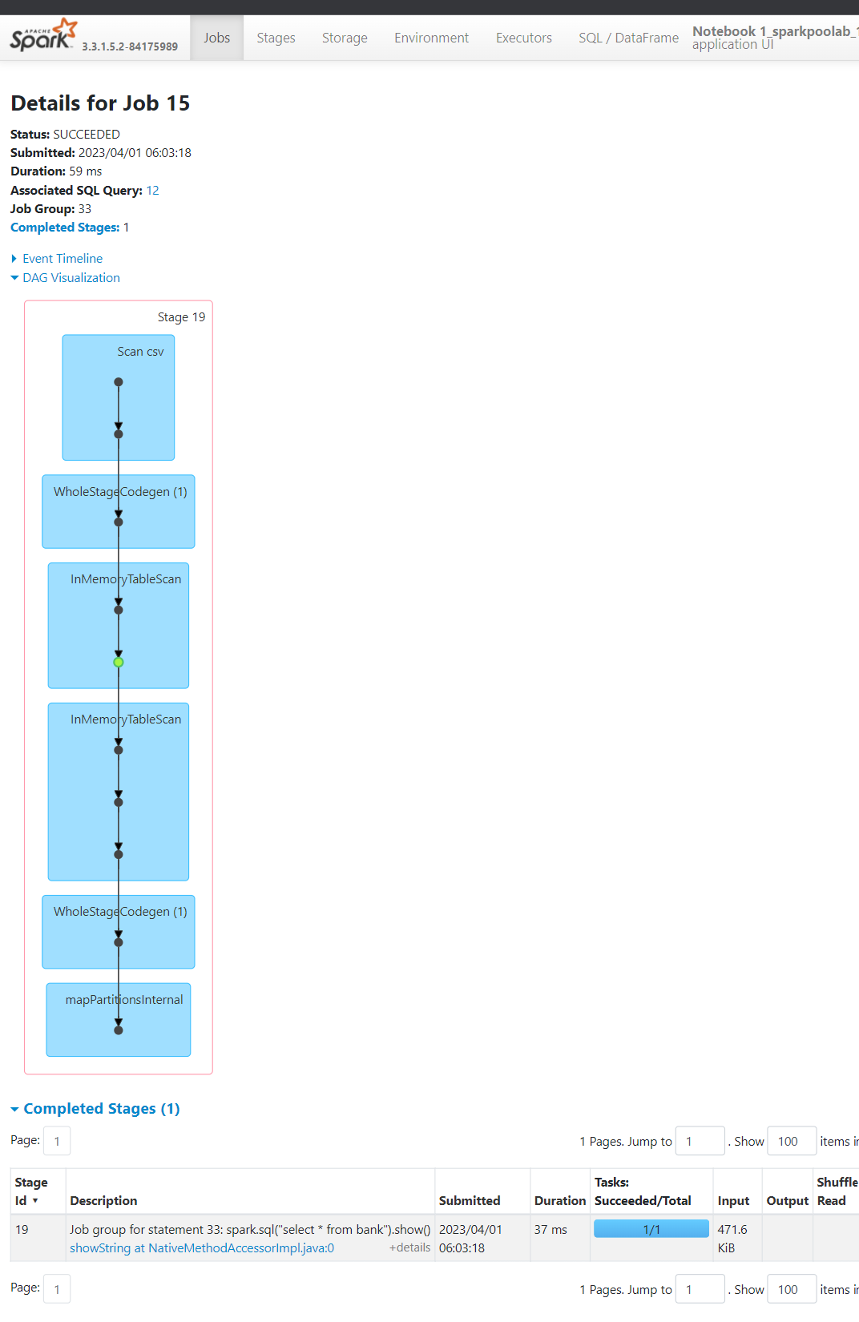
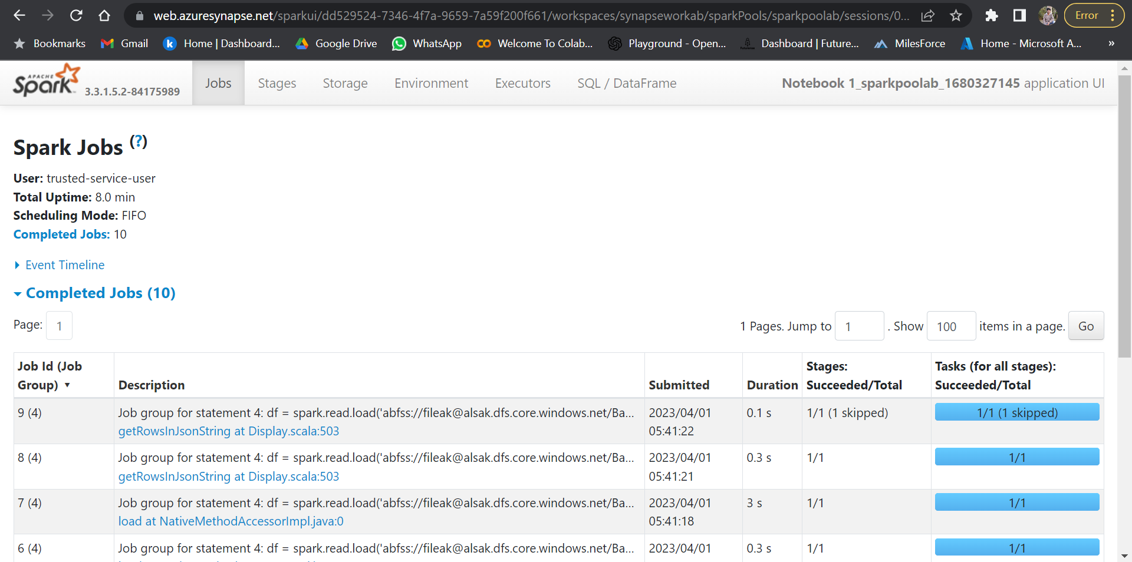
SPARK UI

Slide 38
POWER BI
( v 2.115.663.0)

Slide 39
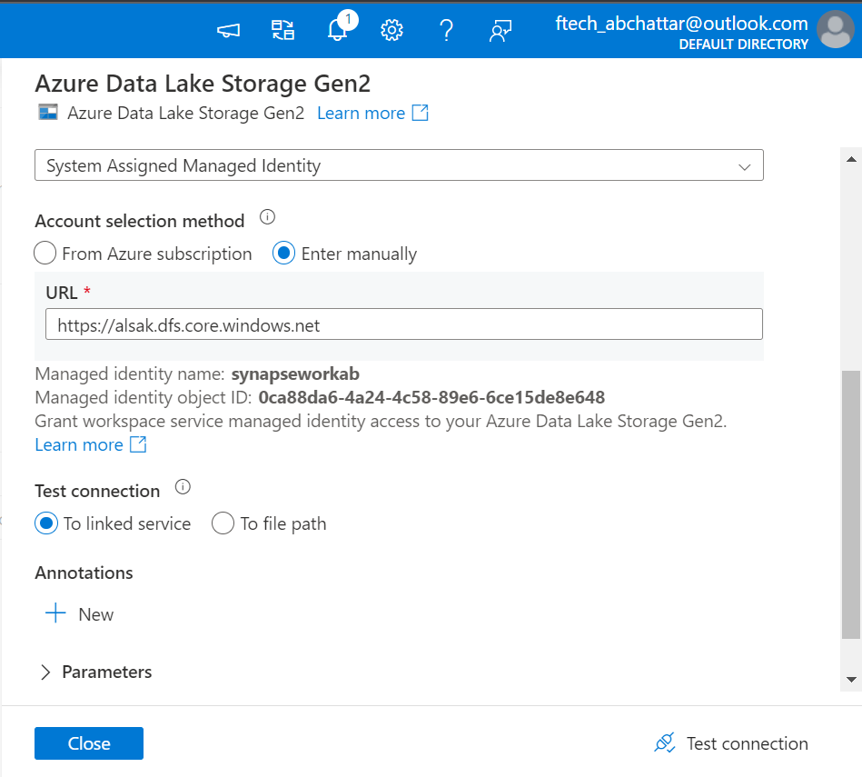
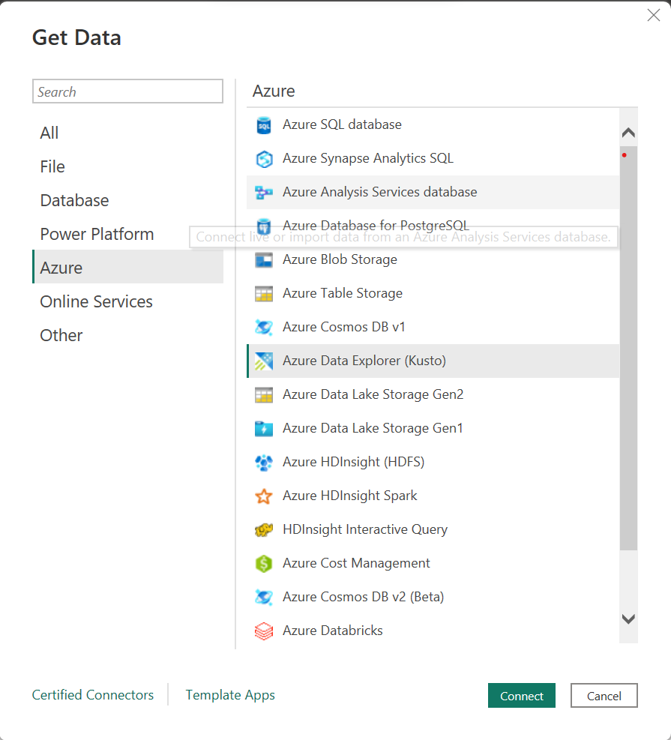
POWERBI CONNECTION

Slide 40
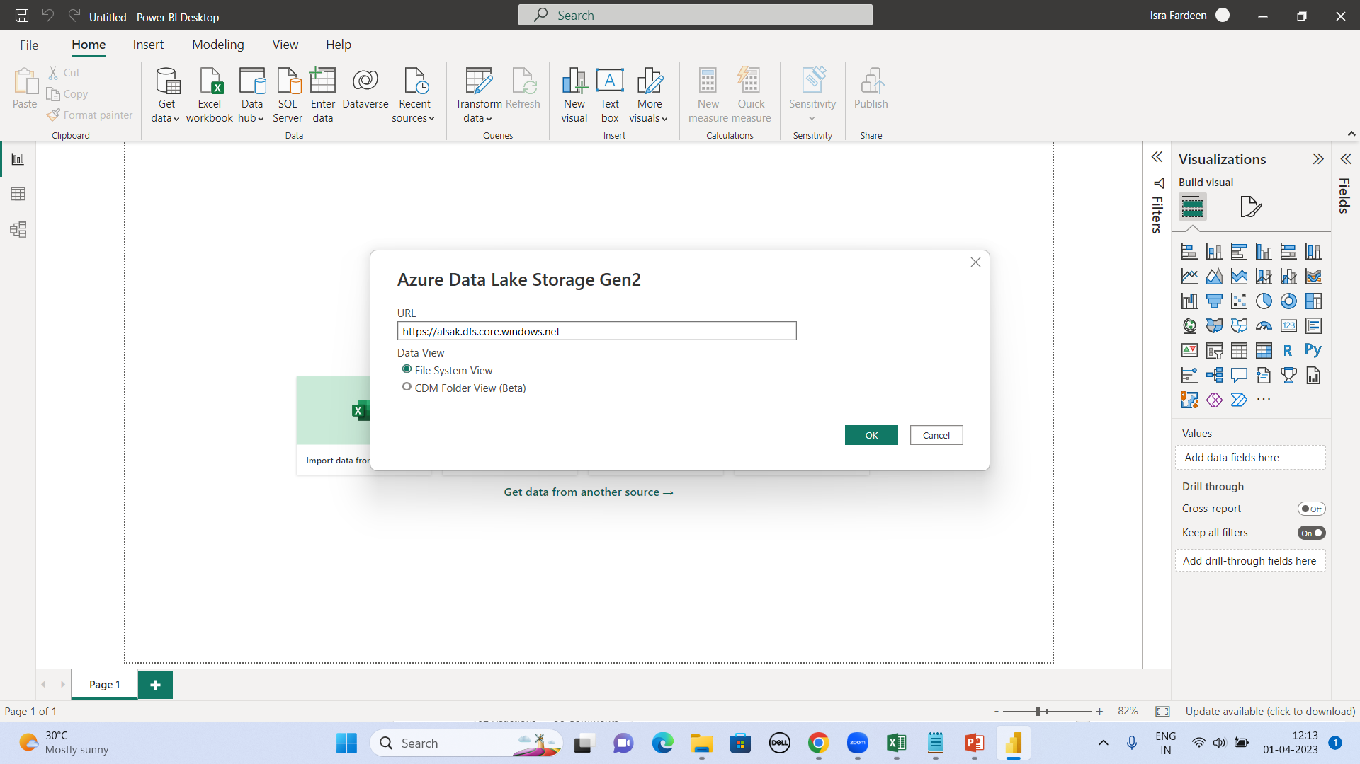
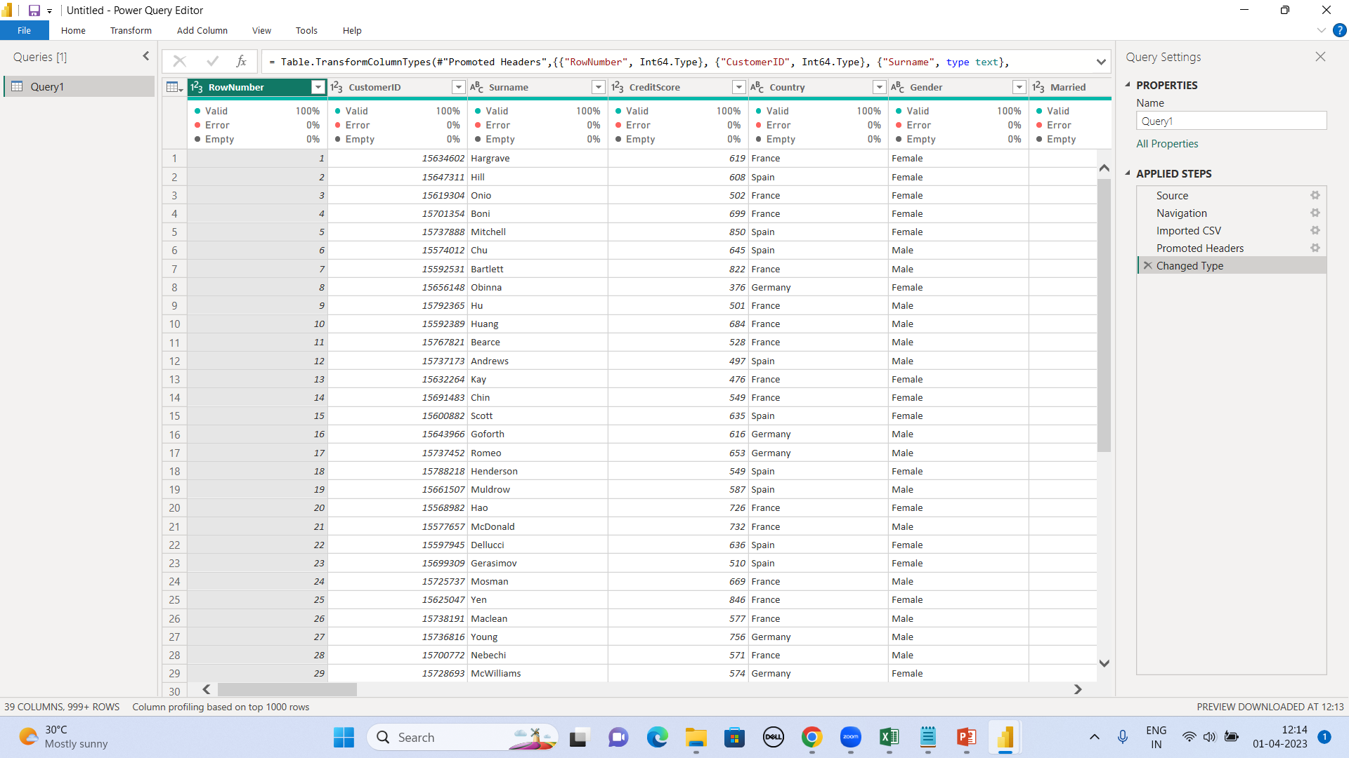
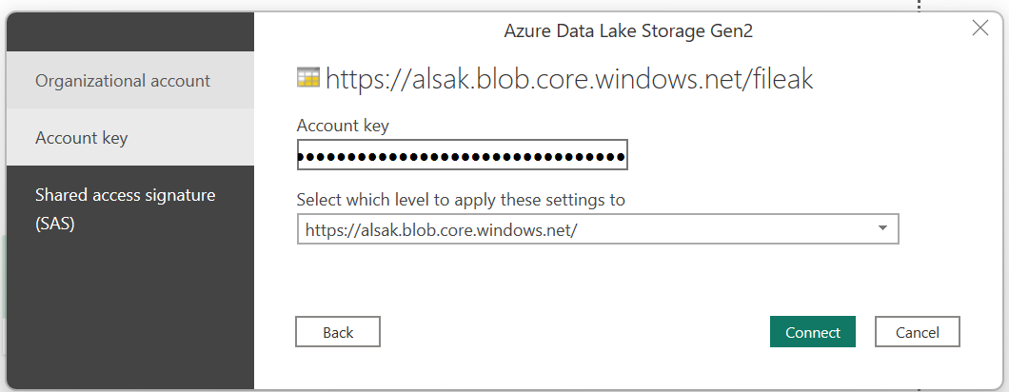

Slide 41

POWER BI VISUALIZATION

Slide 42
CHALLENGES FACED
When compared to MySQL, the queries run on hive had a different syntax
Multiple SQOOP exports failed due to datatype mismatches.
Pipeline Failure.
Enabled a pipeline connection between SQL DB and Databricks to retrieve data from client’s Database, but the pipeline resulted in an authentication error that was resolved later.

Slide 43
FUTURE SCOPE
Using a pipeline, data is to be ingested into the HDInsights to carry out processing and analysis .
Further, a PowerBI workspace on Azure is to be launched by creating a pipeline from SQLDB/ Synapse to PowerBI..

Slide 44
THANK YOU

